Slide 1
International Workshop on ”Towards the transition of sociotechnical system - The new STI policy of OECD”, March 17 2023
Comments and Discussions
Tateo Arimoto
National Graduate Institute for Policy Studies,
Japan Science & Technology Agency and
International Science Council/Fellow

Slide 2
Science and Technology Basic Law (1995）
Japan’s STI Basic Law System, 1995 to 2020 and beyond
Purpose
Science, Technology and Innovation Basic Law
(2020）
Improving the level of science and technology
Creating innovation（new）
Promoting humanities and social sciences（new）
6th STI Basic Plan
(2021～2025)
Three main objectives
Transformation into a sustainable and resilient society that ensures the safety and security of citizens (new)
Strengthen research capabilities to explore the frontiers of knowledge and become a source of value creation
Education and human resource development to realize well-being in society and individual diverse happiness (new)

Slide 3
Multi-layered
Governance System
of STI policy
Top down
Political will, Social demands, Issue-driven,
Policy Making
Science Advice,
Think tank
Share visions & Trust, Concerted
actions
Evidence based policy making, Foresight, Science of STI policy
Ministries
Funding Agencies
Implementing Organizations
universities, industries, national labs etc.
Academies
Bottom up
motivation, incentive,
scientists, engineers, managers etc.
Redesigning STI system to address the changing world
3

Slide 4
International Landscape of STI Policy & Diplomacy
Global
Foreign Minister Sci Adviser Network外務大臣科学顧問ﾈｯﾄｰﾜｰｸ (FMSTAN)
UN 国連, STI for SDGs Forum, World Bank, UNESCO, WHO etc
International Network of Gov. Sci Advice
国際政府科学助言
ﾈｯﾄﾜｰｸ(INGSA)
International Science Council 国際学術会議(ISC)
OECD “STI Policy 2025 –
Ministerial Meeting, April 2024, “New STI Policy”
STS Form &
Japan-EU Policy Forum,
AAAS、ESOF,
GESDA（Geneva）
Regional
G-7（Japan 2023),
G-20, TICAD
USA : OSTP,DOS,NSF, DOE,DARPA,NASEM
World Science Forum (WSF)
WEF,
Welcome Trust,
G-STIC, GSS
UN-Global Compact,
WBCSD,
GFCC,
Keidanren
National Academies,
S-7 (Japan 2023)
EU & DE, FR, NLD
Horizon Europe
Japan：PM, Cabinet off, MEXT, METI, MOFA
JST,NEDO,AMED, JICA
China
National
UK, Canada
Russia
Global Young
Academies
GRC,Belmont Forum,Future Earth,SATREPS,SAKURA Sci, eーAsai
India,AU,NZ,Korea, ASEAN /APEC,
Africa (African Union,TICAD)
Osaka, Int. EXPO 2025
Local
Universities,
National/Local Labs
Local SDGｓ、
SDGs future cities
“Securitization” of STI policy (OECD)
XY axis framework based on UN Report ”GSDR2019”
Academia,
Education
Society, Business, Security
STI Policy
Security Policy
National Security
：G-7, QUAD,,AUKUS
Based on “SDGs and International Research Collaboration”,
April 28, 2021, Tateo Arimoto, at US NAS & Nobel Foundation
Bi-lateral, multi lateral relations and international organizations. Track-I & Track-II：Building integral coordination mechanism to meet the changing structure and functions of STI collaboration and partnership.

Slide 5
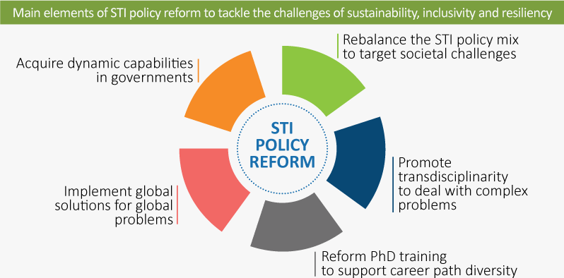
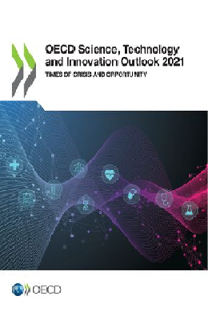
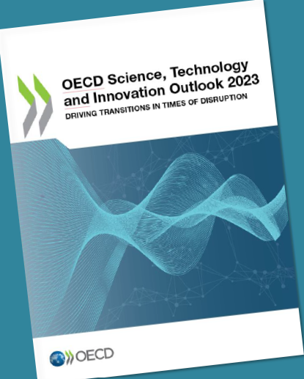
OECD STI Outlook 2021 ⇒ Outlook 2023 ⇒ OECD Ministerial Meeting in April 2024
The pandemic is an opportunity to reorient STI policies and trajectories
１
２
2021
３
４
2023
５
Notes:
Many governments view the pandemic as a stark reminder of the need to transition to more sustainable, equitable and resilient societies
This is highlighted in many countries’ recovery packages, which include expenditures for R&D. Science and innovation will be essential to promote and deliver such transitions.
But the pandemic has exposed limits in research and innovation systems that, if not addressed, will prevent this potential from being realized.
There is therefore a need to reorient STI policies to better equip governments with the instruments and capabilities to direct innovation efforts towards the goals of sustainability, inclusivity and resiliency.
The slides that follow outline some of the issues requiring policy attention.
Memo:
The EU’s NextGenerationEU is a €750 billion temporary recovery instrument to help repair the immediate economic and social damage brought about by the pandemic. Its aim is a post-COVID-19 Europe that will be greener, more digital, more resilient and better fit for the current and forthcoming challenges. More than EUR 600 billion is directed to the so-called Recovery and Resilience Facility (described here: https://ec.europa.eu/commission/presscorner/detail/en/QANDA_21_481), which require Member States to submit plans that devote at least 37% of total expenditure on investments and reforms that support climate objectives; and devote at least 20% of total expenditure on the digital transition.

Slide 6
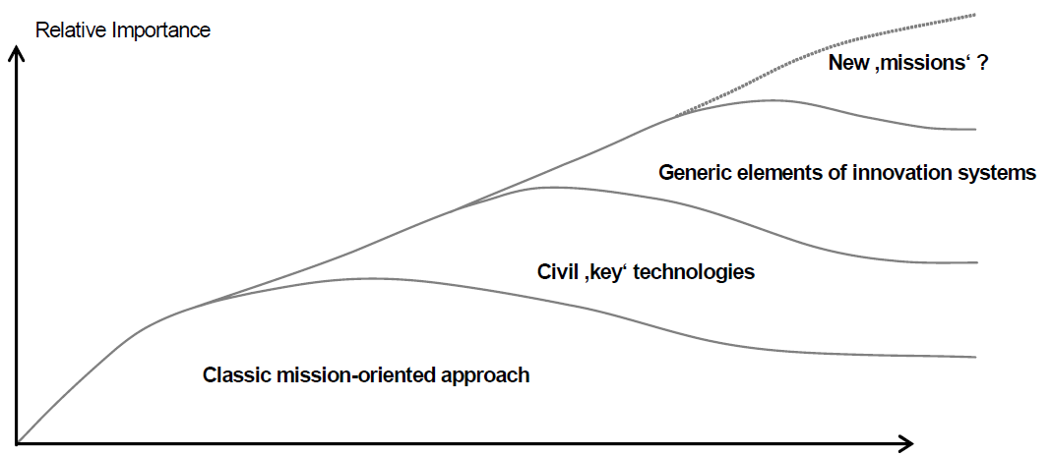
“Securitization of STI”, Economy,
Sustainability, inclusivity, Resilience, Security, & Foreign Policy
Historical Change of STI Policy after WWII
IV. Social transformation approach, “mission–oriented innovation policy”
Corona Pandemic,
Russia-Ukraine War,
US-China Cold war,
Techno-security globalism
Fig. Historical layered framework of Priority Setting in technology policy
III. national innovation
system approachl
*UN STI for SDGs, STI
Roadmap, Pilot Programs
*OECD S&T Policy 2025
*EU Horizon Europe
*ISC, *FMSTAN/INGSA
II. industrial technology policy approach
civil industrial key technologiesl
I. government led technology policy approach
military key technologies, “big science”l
Basic science and technologies
Japan
STI Basic Law 2020 and 6th STI Basic Plan (2021～2025)
World War II
1970’s
1980’s
2010’s
2022～
“Economic competitiveness has been the most dominant rationale for government support to STI activities over the last 30 years in most countries. While this is likely to continue, other rationales are emerging, particularly in light of calls for ‘just’ sustainability transitions, which will affect STI priorities and practices. These rationales include sustainability, inclusivity, resiliency and security.”(OECD, CSTP, Oct 2021)
“Three frames for innovation policy: R&D, systems of innovation and transformative change”, J. Schot and W. E. Steinmuller, Research Policy, 47, 1554-1567 (2018). “Priority setting in Research & Technology Policy- Historical Developments and Recent Trends”, H.Gassler, W.Polt and C.Rammer, InTeReg Working Paper No.36, 2007.

Slide 7
A new type of scientist in the 21st century
ISC and INGSA; “Lessons learned from Covid-19 for the Science-Policy-Society Interface”, Joint submission to UN SDGs High Level Political Forum, July 2021.
“the experience of pandemic has served to illustrate and affirm that boundary roles in the Science-policy-society ecosystem are distinct from the conventional scientific work of research, publication and dissemination. They include: 1. Scientific knowledge generators: researchers and technical experts. 2. Scientific knowledge synthesizers: with specialized skills in knowledge integration and meta-analysis. 3. Scientific knowledge brokers: those who work as multidirectional conduits between SPI stakeholder groups. 4. Science communicators.”
パンデミックの経験は、科学-政策-社会のエコシステムにおける境界の役割の重要性を認識させ、研究、発表、普及という従来の科学的作業とは異なることを明らかにした。それらは以下を含む。1. 科学的知識の生産者：研究者や技術専門家。 2. 科学的知識の統合者：知識の統合やメタ分析の専門的能力をもつ者。 3. 科学的知識の仲介者：エコシステムの関係者を多面的に繋ぐ者。4. 科学コミュニケーター
EU/Joint Research Center, “Science for Policy Handbook”, October 2020
The Changing Relationship between Policy, Science and Society; “ It is clear that any organization wishing to translate knowledge into policy advice must reflect on the profound recent changes observed in the science, society and policy nexus.” 政策・科学・社会の関係の変化：知識を政策助言に結びつけようとする組織は、３者の関係性の最近の大きな変化を反映しなければならない。
The importance of boundary organizations and skills. 架橋する組織と能力の重要性。
“A new type of scientist is needed, one that is motivated by the policy impact they can have, as well as scientific curiosity and academic reputation. Constant interaction and cooperation between science and policy should be the main working method. 新しいタイプの科学者が必要とされる。科学的好奇心や学術的評価にくわえて、政策的影響に動機づけられて、科学と政策の間の絶え間ない相互作用と協力を主な仕事の方法とする者である。

